Slide 1

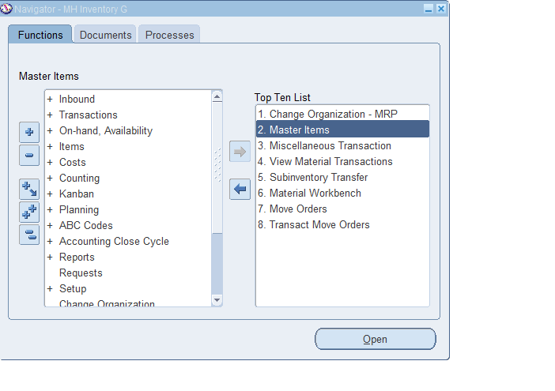
Oracle inventory
Operating unit (MHGROUP)
MASTER ORGANIZATION(MHG)
INVENTORY ORGANIZATION(PV1-PE1-CA1-PK1)

Slide 2
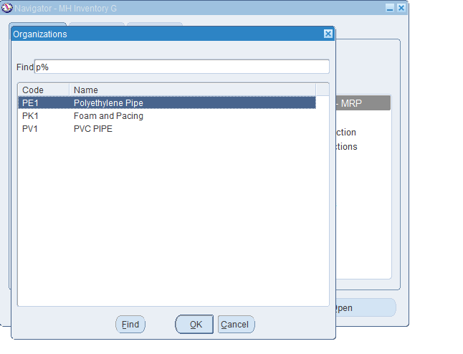
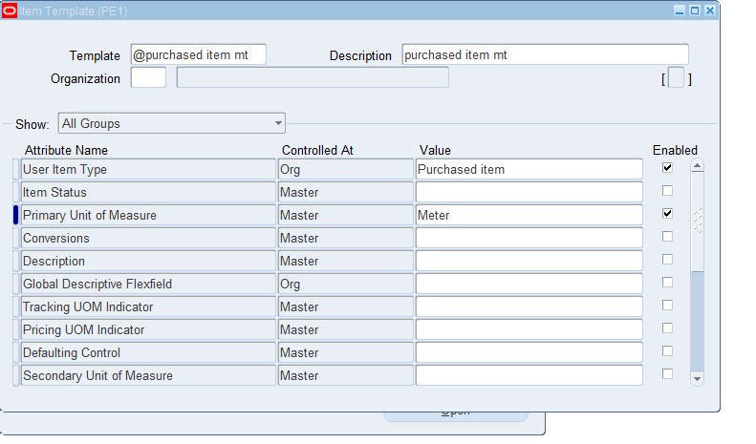
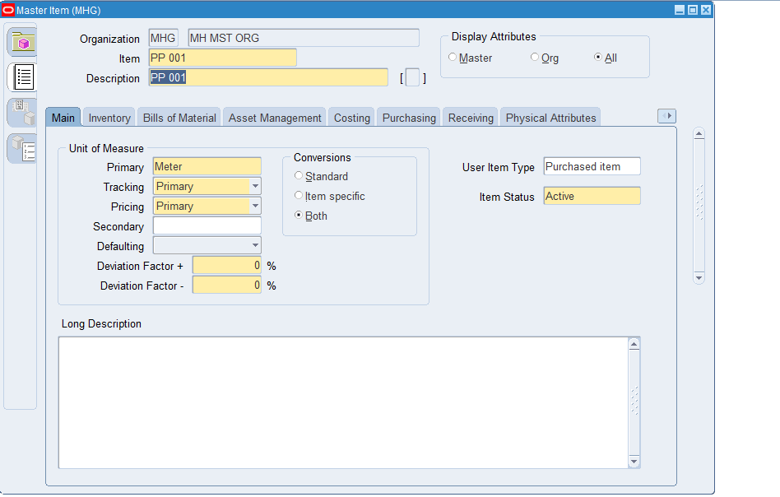
1
CHANGE ORGANIZATION
2
CREAT TEMPLATE
3
CREAT ITEMS

Slide 3
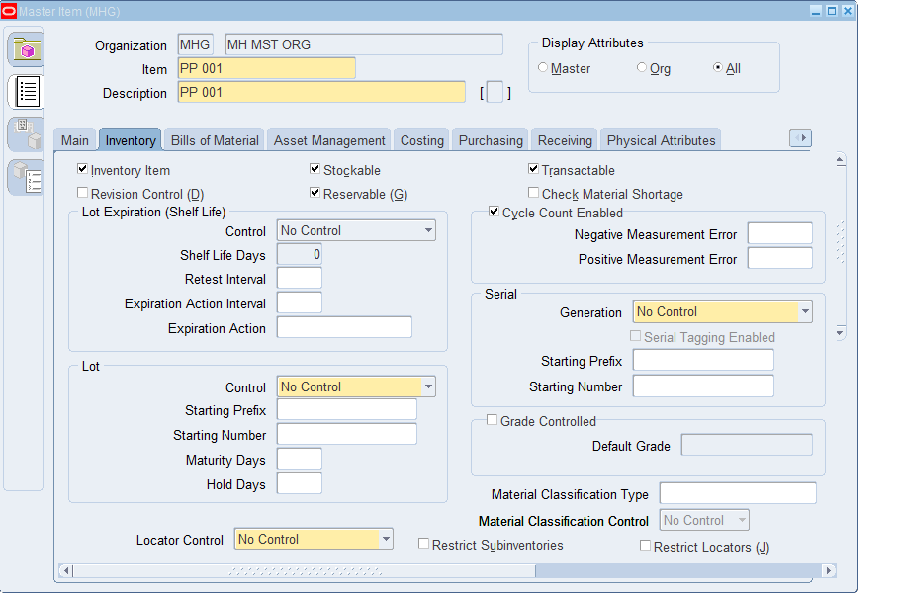
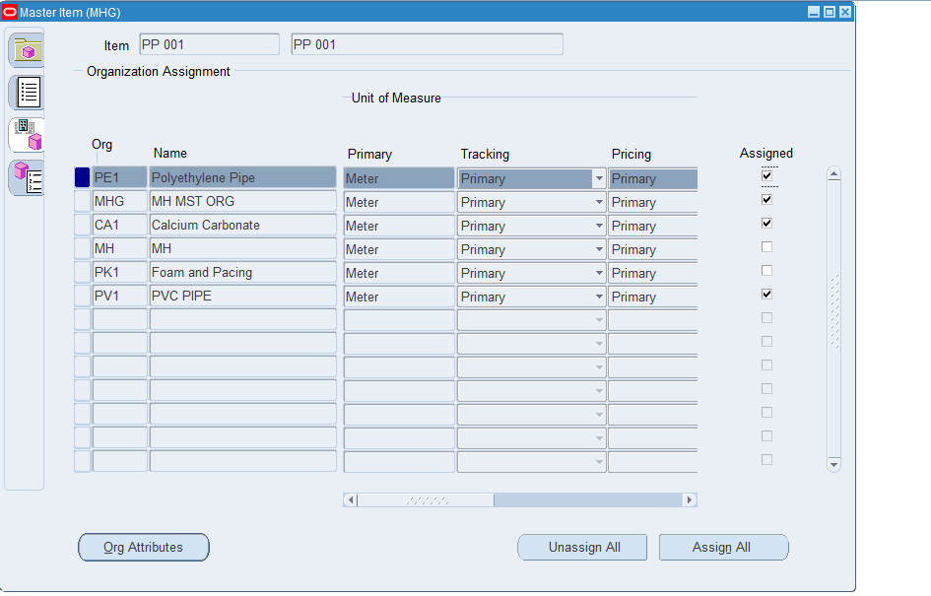
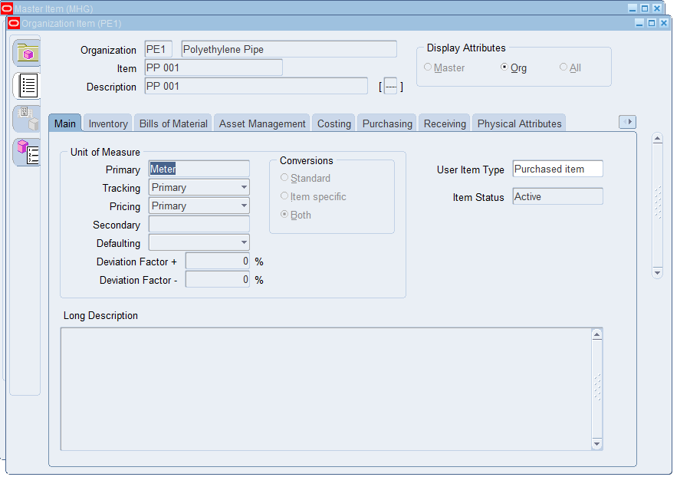
1
INVENTORY TABS
2
ORGANIZATION ASSIGNMENT
3
ORGANIZATION ITEMS (PE1)

Slide 4
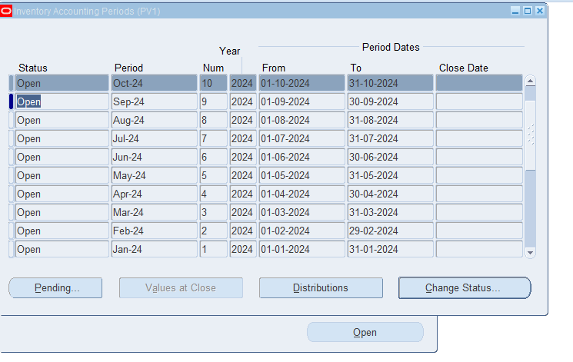
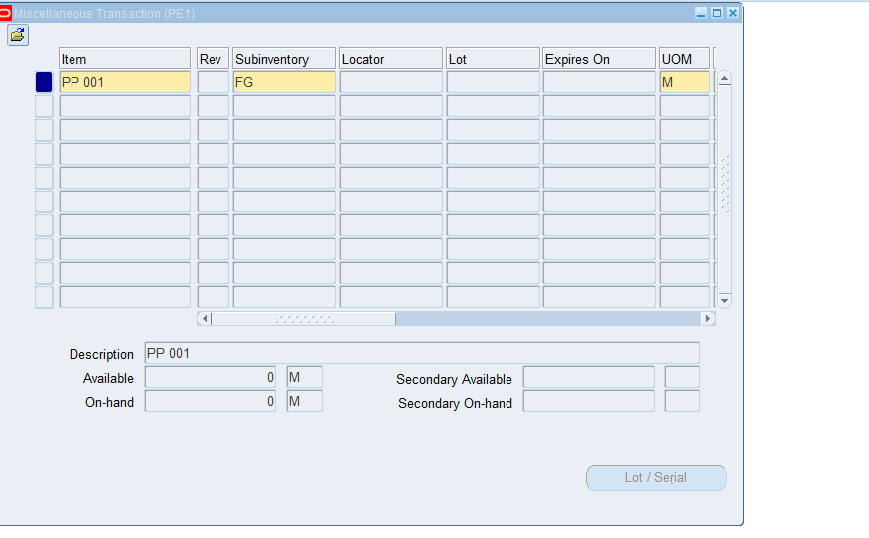
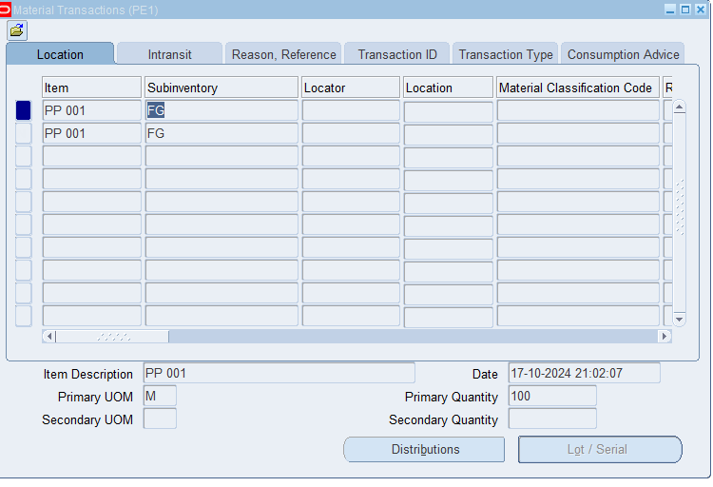
1
INVENTORY ACCOUNTING PERIODS (PV1-PE1-CA1-PK1)
2
MIISCELLANEOUS TRANSACTION (PE1)
3
MATERIAL TRANSACTION (PE1)

Slide 5
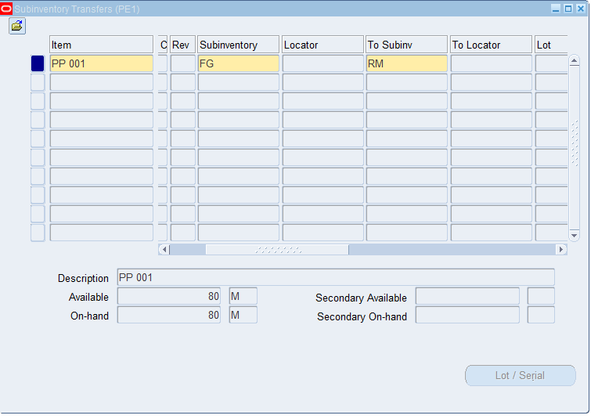
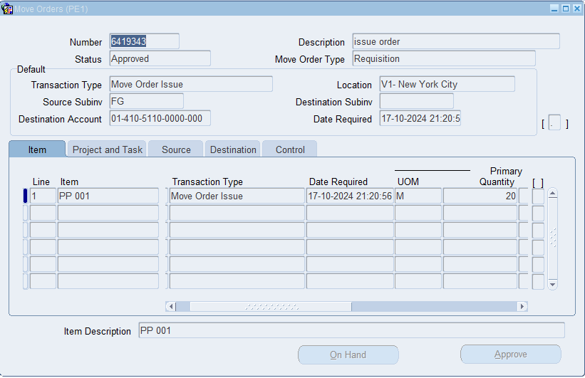
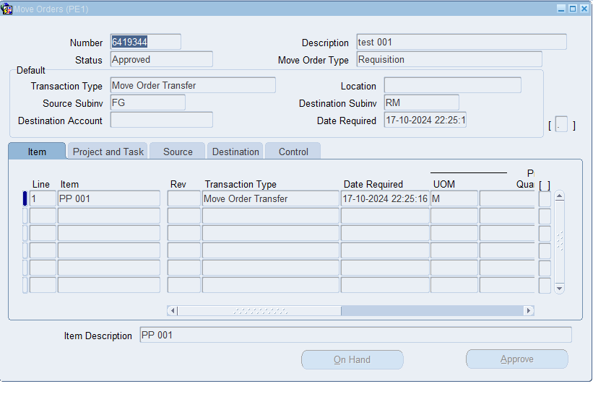
1
SUB INVENTORY TRANSFERS
2
MOVE ORDER ISSUE(PE1)
3
MOVE ORDER TRANSFERS(PE1)

Slide 6
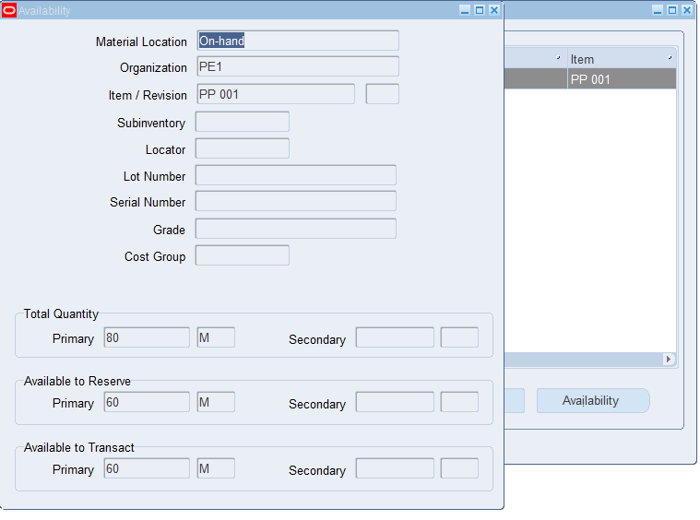
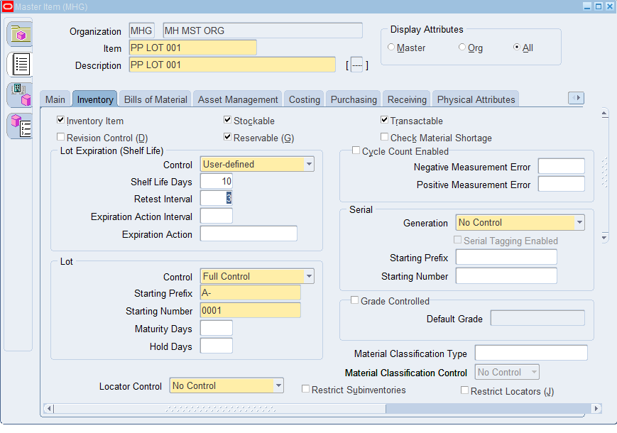
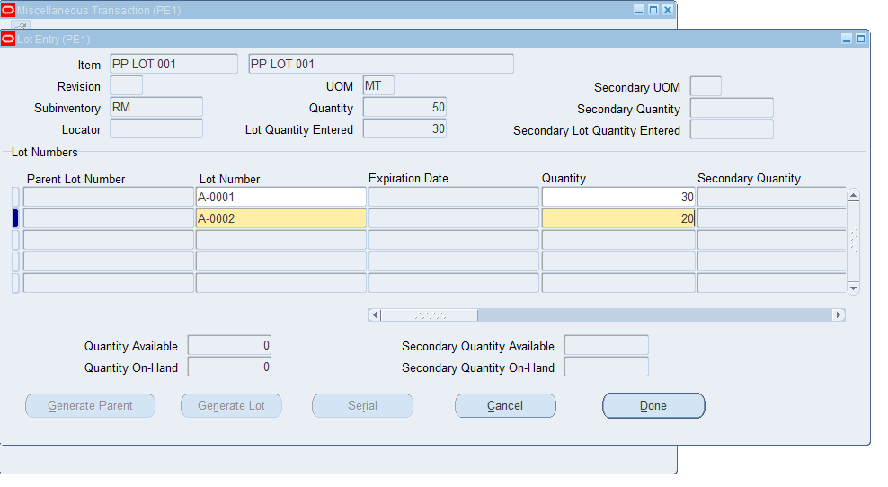
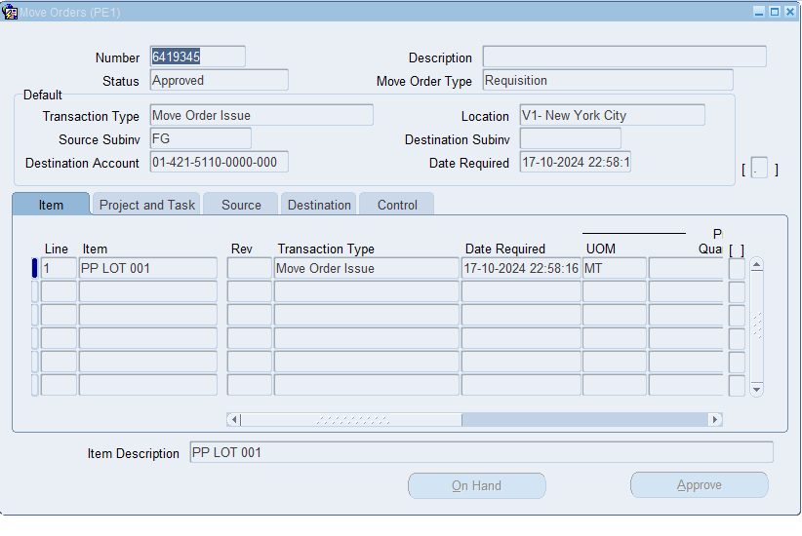
1
ON-HAND
2
LOT EXPIRATION
3
TRANSACTION –MOVE ORDER

Slide 7
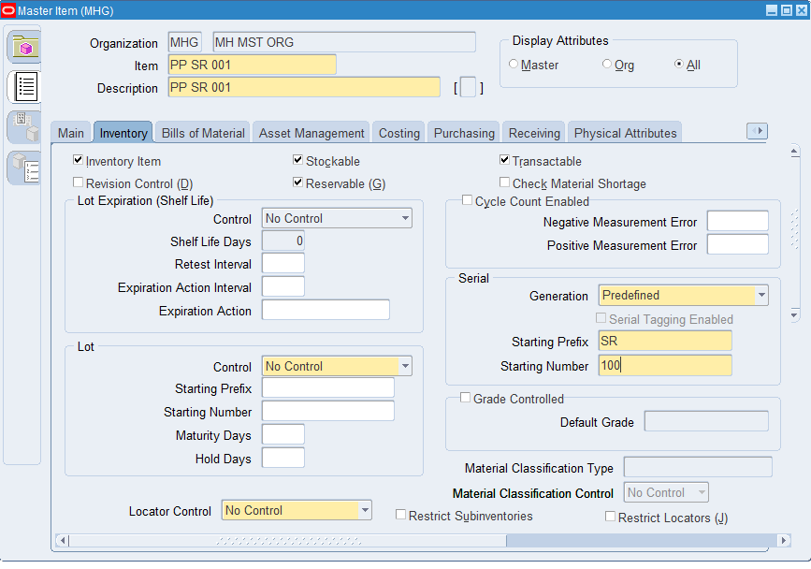
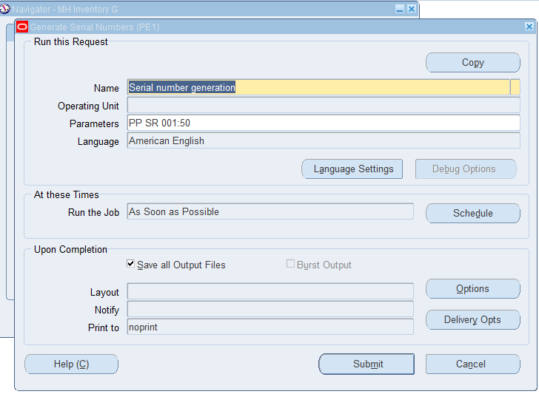
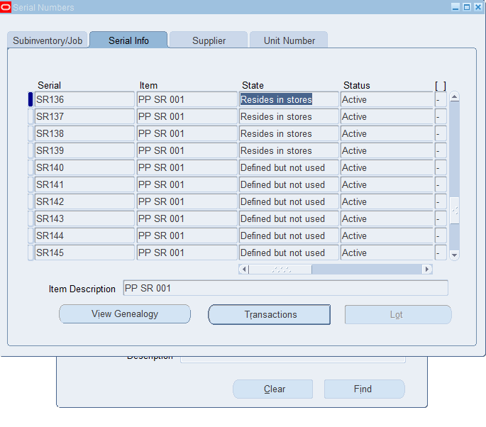
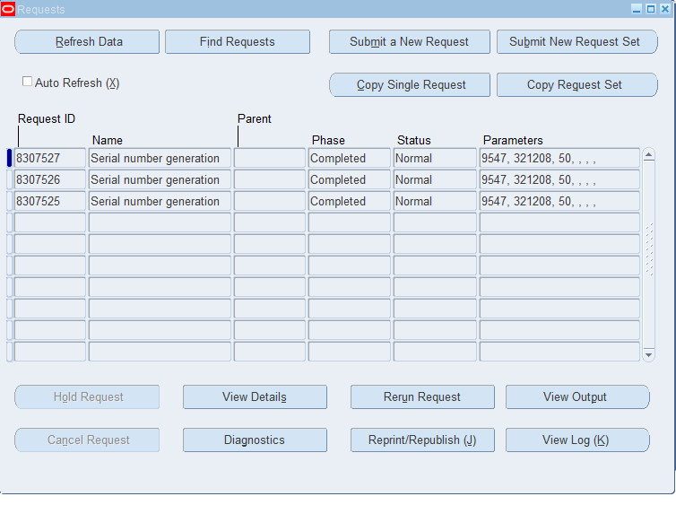
1
SERIAL ITEM
2
GENERATE SERIAL
3
REQUESTS

